Slide 1
Fostering co-operation within the CertiLingua network
A project between Lombardy (Italy) and North Rhine-Westphalia (Germany)
21 September 2021

Slide 2
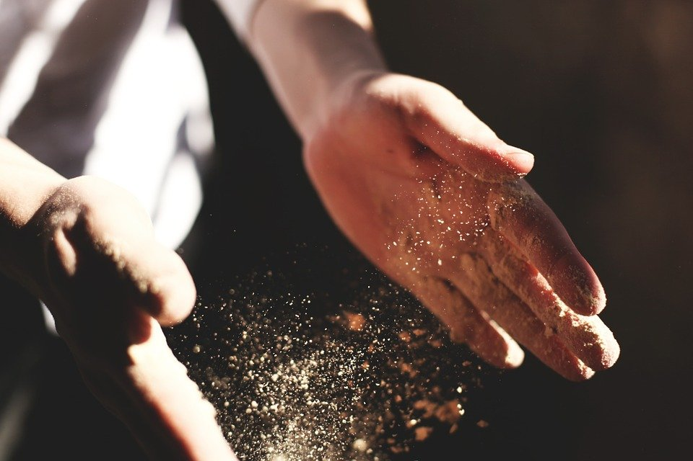

Slide 3
Good ideas are like dust, you can‘t stop them from rising
More than one hand is needed to realise them

Slide 6
10 February: webinar „in Italy“: „CertiLingua Project Documentations with audio-visual elements“
about 100 participants, 3 hours
can-do-spirit, enthusiam
quick and dirty organisation of a „dating event“
19 April: online meeting:
14 schools from Lombardy & 21 North Rhine-Westphalian schools

Slide 7
organisation
set date
discuss setting
„registration“
contact schools
have them register
matching
languages
interests
group size
done in Italy
by a team of four people

Slide 8
1 | Istituto Omnicomprensivo Statale Europeo di Arconate e Buscate | Geschwister-Scholl-Gymnasium
2 | ITE Enrico Tosi | Grafschafter Gymnasium
 |  | Gymnasium Fabritianum
3 | ITE LL Gadda-Rosselli | Rudolph Brandes Gymnasium
4 | Licei Manzoni Varese | Gymnasium Brede
5 | Liceo Legnani | Hermann-Vöchting-Gymnasium
6 | Liceo Linguistico Europeo G.Parini | Stadtgymnasium Detmold
7 | E. Setti Carraro Dalla Chiesa | Gymnasium Am Kothen
8 | Liceo Galileo Galilei | Otto-Hahn-Gymnasium / Herne
 |  | Gymnasium Heepen
9 | IIS Carlo Emilio Gadda | Gesamtschule Hardt
 |  | Gymnasium Schwertstraße
10 | I.I.S. P. FRISI | Kopernikus Gymnasium
 |  | Krupp Gymnasium
11 | Liceo G. Novello | Städt. Anno-Gymnasium
 |  | Otto-Hahn-Gymnasium / Mohnheim
12 | Liceo Linguistico "D.Manin" | MEG Tönisvorst
 |  | Cecilien-Gymnasium
13 | Liceo Agnesi | Städt. Mädchengymnasium Essen
14 | Liceo Crespi | Hollenberg Gymnasium Waldbröl
 |  | Städt. Gymnasium Barntrup
by the end of the day: we „just“ provided a meeting space

Slide 9
I was able to find partners for three students […] for their CertiLingua work. The girls have a regular exchange with the students from Italy […].
We would also like to maintain contact with the school for other projects, e.g. internships abroad.
If it continues to be difficult to carry out face-to-face projects due to the pandemic, I will also arrange contacts for interested Q1 pupils.
LICEO MANZONI, Varese
GYMNASIUM BREDE, Brakel

Slide 10
A virtual padlet has been created […] where the students from Italy and Germany have posted videos and briefly introduced themselves.
In the coming weeks, a kind of 'speed dating' will take place via videoconference, so that the students can find partners with whom they can then develop their CertiLingua project via email and videoconferencing.
LICEO G. NOVELLO, Codogno
ANNO-GYMNASIUM, Siegburg
OTTO-HAHN-GYMNASIUM, Monheim

Slide 11
Currently, a student […] is in talks with her Italian partner on the topic of LBGTQ. In cooperation, the two intend to conduct questionnaires on the acceptance of the topic at their respective schools. Another student from Q1 is in the planning phase. The topic in the foreground here is to be the Oriental region; communication with the partner in Italy is very intensive in this regard.
LICEO GALILEO GALILEI, Legnano
GYMNASIUM HEEPEN, Bielefeld

Slide 12
Clelia Nebuloni, Liceo Galileo Galilei:
main objective of the student’s Certilingua project: the acquisition of European and international competences
central features:
the face-to-face encounter and the international aspects
COVID pandemic:
the students lack face-to-face encounters
Connecting classrooms:
a way out and a challenge

Slide 13
Schools Twinning : Liceo Galilei in Legnano (Lombardy) GymnasiumHeepen in Bielefeld (Nordrhein Westfalen ) Otto-Hahn Gymnasium in Herne ( Nordrhein Westfalen)
pairing according to common interests
state of the project : work in progress
ITALIAN STUDENT | GERMAN STUDENT | THEME/TOPIC | FINAL PRODUCT | DEADLINE
GIORGIA LICEO GALILEI | SOPHIE Gymnasium Heepen | LGBTQ+ communities in the two countries | A WRITTEN REPORT | Christmas holidays 2021
DALILA LICEO GALILEI | PAULA Otto-Hahn-Gymnasium | Language preferences and education | A WRITTEN REPORT | Christmas holidays 2021
MARTINA LICEO GALILEI | INES Gymnasium Heepen | EASTERN CULTURES
CHIARA LICEO GALILEI | LETIZIA Gymnasium Heepen | ITALIAN AND GERMAN school systems | A POSTER
GIULIA LICEO GALILEI | NELLY Otto-Hahn-Gymnasium | ?????
emails – text messages – web meetings

Slide 14
THE ROLE OF THE TEACHERS
Motivate the students and keep motivating them throughout the whole project
Support them
- Provide them with any information or explanation they may need
- Encourage them to be creative
- Foster them to use their language skills
DRAWBACKS – ISSUES :
This “distant” project takes longer than a “real” face-to -face project
A student of the tandem may not reply to any messages or emails for weeks or quit

Slide 15
ADVANTAGES
Students
carry out a face- to face (though virtual) international experience: essential for Certilingua
practice the foreign language or one of the foreign languages they have been learning
meet people belonging to different cultures
share opinions , ideas , different points of view
become more confident
get involved in something innovative and creative

Slide 16
By taking part in this project I can prove my language skills and then I’ve known Letizia , who I hope to meet soon and not only on the screen (Chiara)
Working at this project will allow me to study and analyze something which is completely new to me (Martina)
I’m so excited to take part in this project since it has given me the opportunity to meet a foreign student and to find out differences in our countries (Giorgia)

Slide 17
Why has this been so succesful?

Slide 18
shared
European integration
shared goal:
enable international „CertiLingua“ contacts
cooperation
connecting students from
different cultures

Slide 19
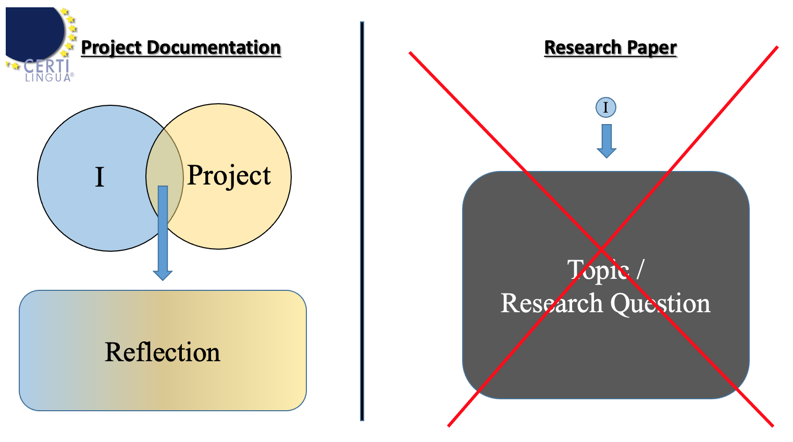
Focus on students‘ intercultural competences

Slide 20
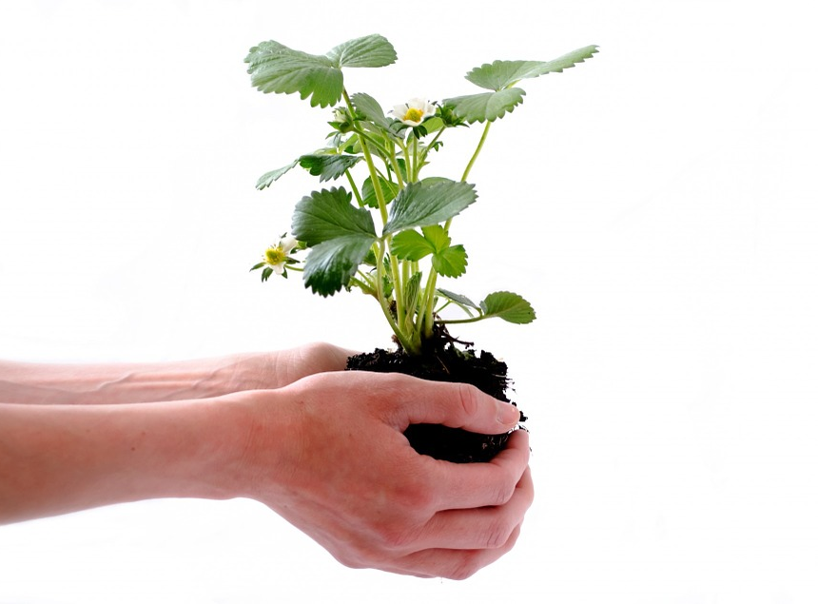
international
competences –
documentation
project
Counselling is key

Slide 21
innovation is welcome

Slide 22
give & take
contribute what you can
practise what you preach
European cooperation
STRENGTHENING NETWORKING

Slide 24
all pictures taken from pixabay
no licence required

